Slide 1

Git LFS
簡報 http://gitlfs.rsync.tw
haway@gandi.net

Slide 2
Git V.S. 大型檔案
GitHub/GitLab
Git
repo
Git
repo
Git
repo
Git
repo
Git
repo
push
100MB
100MB
100MB
100MB
100MB

Slide 3
Remove it ?
GitHub/GitLab
> git rm 100MB
> git commit -m ‘rm 100MB’
> git push
Git
repo
push
100MB

Slide 4
Git Repository
All contents were saved in repository.
Git Repository
v1
v2
v3
master
pull
100MB
100MB
100MB
Git
repo

Slide 5
Git Histroy
You can’t delete files that saved in the repository.
Pull project will download all objects(codes, configs, documentation, binary files) in the master branch.
One Large file saved in the repository destroy everything (GG).

Slide 6
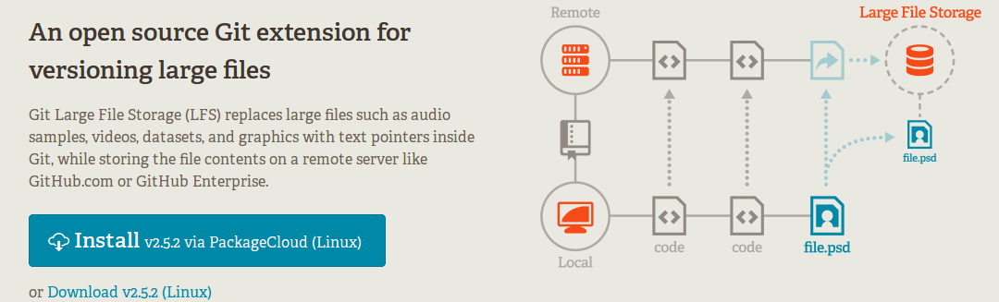
Git Large File Storage (LFS)

Slide 7
Installation instructions
https://packagecloud.io/github/git-lfs/install
git lfs install

Slide 8
Getting Started
git lfs track “*.psd”
git add .gitattributes
git add file.psd
git commit -m ‘Add psd file’
git push origin master

Slide 9
git lfs track “file”
You have to “git track files” before you commit it.
It will generate a “.gitattributes“ file automatically and save information in it.

Slide 10
git add .gitattributes
Customizing Git
Identifying Binary Files
Diffing Binary Files
keyword Expansion
Exporting Your Repository
Merge Strategies

Slide 11
Demo

Slide 12
Quiz Time！
How can manage large files without Git LFS ?

Slide 13
Branch
master
prod
git checkout -b prod
git add file.iso
git merge master
CI push prod branch to production
Developer：
git clone project master
iso

Slide 14
Client Tools
https://github.com/git-lfs/git-lfs/wiki/Installation

Slide 15
Requirement
Git > 1.8.5
GitLab > 8.2
GitHub support now available.

Slide 16
Direct/Background upload in GitLab
Direct upload：
User pushes an lfs file to the GitLab instance
GitLab-workhorse uploads the file directly to the external object storage
GitLab-workhorse notifies GitLab-rails that the upload process is complete
Background upload：
User pushes an lfs file to the GitLab instance
GitLab-rails stores the file in the local file storage
GitLab-rails then uploads the file to the external object storage asynchronously
https://docs.gitlab.com/ee/workflow/lfs/lfs_administration.html

Slide 17
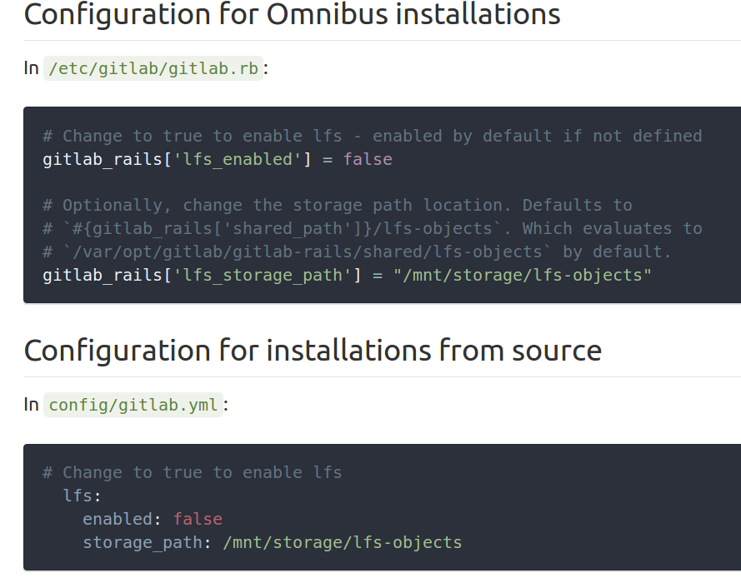
Enable LFS in your GitLab

Slide 18
Direct/Background upload in GitLab
Direct upload：
User pushes an lfs file to the GitLab instance
GitLab-workhorse uploads the file directly to the external object storage
GitLab-workhorse notifies GitLab-rails that the upload process is complete
Background upload：
User pushes an lfs file to the GitLab instance
GitLab-rails stores the file in the local file storage
GitLab-rails then uploads the file to the external object storage asynchronously
https://docs.gitlab.com/ee/workflow/lfs/lfs_administration.html

Slide 19
.gitattributes

Slide 20
Customizing Git - Git Attributes
Identifying Binary Files
Customize each file process when git show/diff/checkout/commit
Create a .gitattributes in your project directory or,
Save in .git/info/attributes then you don’t need .gitattributes( also don’t need to commit )

Slide 21
Identifying Binary Files
in .gitattributes:
*.pbxproj binary

Slide 22
Customizing - Diffing Binary Files
docx(http://docx2txt.sourceforge.net/):
*.docx diff=word
$ git config diff.word.textconv docx2txt

Slide 23
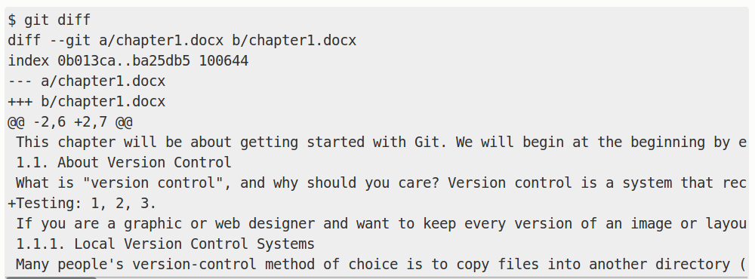

Slide 24
Customizing - Diffing Binary Files
png:
*.png diff=exif
$ git config diff.exif.textconv exiftool

Slide 25
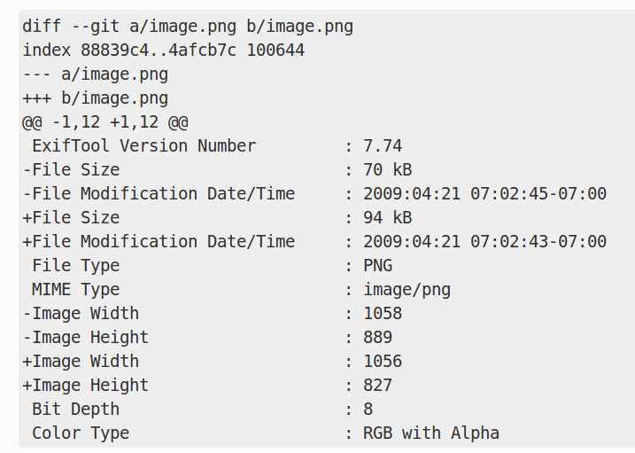

Slide 26

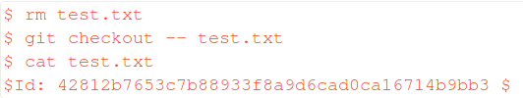
Customizing - Keyword Expansion

Slide 27
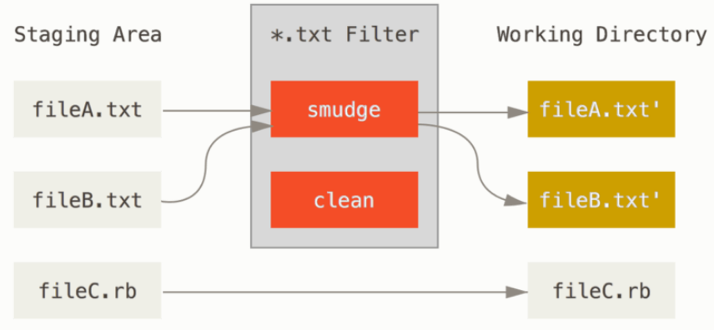
Customizing - Keyword Expansion
Checkout

Slide 28
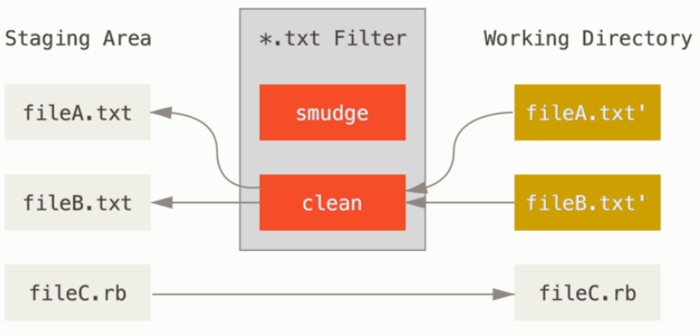
Customizing - Keyword Expansion
Add

Slide 29
Keyword Expansion - example 1/3
a1.py:
# $Date$
import …
abc = “abc”
for ...

Slide 30
Keyword Expansion - example 2/3
$ git checkout a1.py
$ cat a1.py
# $Date: Tue Apr 21 07:26:52 2009 -0700$
import …
abc = “abc”
for...

Slide 31
Keyword Expansion - example 3/3
$ git config filter.dater.smudge expand_date $ git config filter.dater.clean 'perl -pe "s/\\\$Date[^\\\$]*\\\$/\\\$Date\\\$/"'
epeand_date.ruby:
#! /usr/bin/env ruby data = STDIN.read last_date = `git log --pretty=format:"%ad" -1` puts data.gsub('$Date$', '$Date: ' + last_date.to_s + '$')

Slide 32
Customizing - Exporting Your Repository
export-ignore
add in .gitattributes:
test/ export-ignore

Slide 33
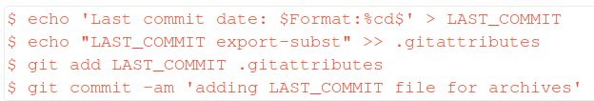
Customizing - Exporting Your Repository
export-subst

Slide 34
Customizing - Merge Strategies
Add database.xml in .gitattributes:
database.xml merge=ours
$ git config --global merge.ours.driver true
$ git merge topic Auto-merging database.xml Merge made by recursive.

Slide 35
QA

